Slide 1
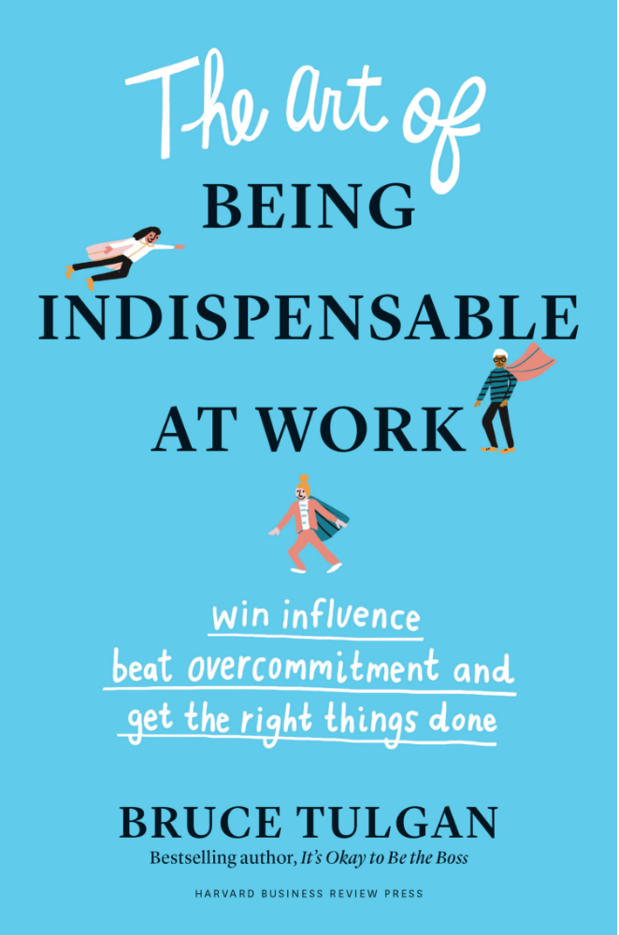
This is the first in a series of webinars based on my new book…
Coming out this Summer with HBR Press.

Slide 2
How can you succeed right now?
Today’s world of work is increasingly demanding and uncertain.
You must navigate through constantly shifting priorities and unclear lines of authority.
There are so many factors outside your control.

Slide 3
If ever there was a time…

Slide 4

Go-to-ism: The way of the go-to person.
Adopt a true service mindset. The more you serve others, the more they want to build you up and help you out too.
People are more likely to work things out with you, or take your word, when you are known for being aligned with the chain of command and making the right decisions.
When you can get things done very well, very fast for people, those people will keep coming back to you.
In this incredibly uncertain post-pandemic world, people will be our anchors: Be a go-to person and build up your network of go-to people upon whom you know you can rely. Invest in each other, with intention.

Slide 5
These are the go-to people… Be one.
When boom goes to bust, who is still indispensable?
Who will keep adding value, no matter what?
Who will lead us through tough times?
Who will pull more than their weight?
Who will help us adapt and bounce back stronger than ever?
Who will keep doing their best work very well, very fast, on time and on spec?
Who will do all this and keep building up (rather than damaging) their working relationships in the process?

Slide 6
Your job just got a lot more difficult and complicated.
You and your colleagues, all over the organization chart, are relying on each other even more now than before.
Many, after sheltering in place during the pandemic, will continue working remotely.
Everybody will be under added stress for the foreseeable future, doing more with less, and tackling entirely new obstacles along the way.
Every new request will feel like a special occasion.
You don’t want to let anybody down, especially in this new world. You will want to keep proving yourself to be that indispensable go-to person.

Slide 7


STEP ONE:
FIGHT OVERCOMMITMENT SYDNROME
If you try to do everything for everybody, you will end up doing nothing for anybody.
Now more than ever, it will take extra savvy and skill to manage yourself, your many working relationships, and all the competing demands on your time and talent.

Slide 8

Some hard realities
Positive attitude, hard work, personal responsibility, and being great at your job are just table stakes.
No matter how creative and tenacious you may be, you still have to do things by the book and follow orders.
You cannot do everything for everybody.
You can’t be great at everything.
You only get credit for the results you deliver. You get a lot more credit when you deliver on time and on spec.
People are your number-one asset, but they are also very high maintenance, so managing relationships is mission critical.

Slide 9
STEP TWO: UNDERSTAND THE PECULIAR MATHEMATICS OF REAL INFLUENCE
It is not a zero-sum game.
Its value resides in the minds of others, but it works to your benefit.
It is completely intangible but can have enormous real-world consequences.
It can accrue quickly and grow quickly, but it is a long- term asset.
It’s incredibly valuable, but you cannot buy it.
People will do things for you based on it, but there is no quid pro quo involved.
Spending it, lending it, and giving it away just makes its value grow.
It builds and builds whenever you add value for others.

Slide 10
Real influence
The power people give each other because they want each other to be powerful.
The power you have when other people really want to do things for you, make good use of your time, and contribute to your success.

Slide 11
False influence
Bribe your colleagues or otherwise seek to establish a quid pro quo
Threaten to withhold support for them in the future
Badger, bully, and/or manipulate them
Charm and flatter or otherwise seek to ingratiate yourself with them
Point fingers, blame, complain, or otherwise undermine them
Go over their heads

Slide 12

False influence versus real influence
False influence—pressure on people to get them to comply–-might get you what you want in the very short term or even for a while. Most likely, though, people will root against you, wish for your failure, or work to take away your power, not give you more.
The only way to build real influence is to focus on serving others, adding value in every interaction, doing the right things for the right reasons, playing the long game, one moment at a time.
You see, the math is peculiar.

Slide 13



STEP THREE: LEAD FROM WHEREVER YOU ARE
Up, down, sideways… and diagonal.

Slide 14
You have to go vertical before you go sideways… or diagonal.
Go over your own head, first: Know what’s required and what’s allowed.
Make sure your direct reports so they understand their marching orders and have the authority to make the necessary choices to get their work done.
Ensure alignment on priorities, ground rules, and marching orders, and next steps, every step of the way, through regular structured communication.

Slide 15
Once you are aligned up and down, you can go sideways… and diagonal.
Put structure and substance into more of your unstructured communication.
Be known as a great meeting citizen.
Schedule regular one-on-ones with your regular interrupters and with those whom you interrupt on a regular basis.
When you are managing diagonally down, stay aligned with that person’s direct boss. When you are managing diagonally up, stay aligned with your boss.

Slide 16



STEP FOUR:
KNOW WHEN TO SAY NO AND HOW TO SAY YES

Slide 17
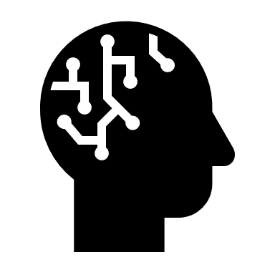
Every good choice you make now…
Every good choice now will save everybody so much time and trouble later and will make others more confident in your choices in the future.

Slide 18
Take other people’s needs seriously.
Give every ask its due diligence.
Tune in to every ask with an intake memo.
Ask good questions and build a proposal from the inside out.
Use this approach to guide your own asking, too.

Slide 19
Learn when to say “no” or “not yet”
THE “NO GATES”:
  I cannot do it.
  I am not allowed to do it.
  I should not do it… it is not a good idea or the right time… or at the top of my priority list.
The answer might be “not yet.”

Slide 20
Yes is where all the action is…
Every yes is your opportunity to add value for others and build up your real influence. Don’t waste your “yeses.” Set up every “yes” for success with a concrete plan—ground rules for working together, a cadence for communicating; and a clear sequence, timing, and ownership of all the next steps.

Slide 21

STEP FIVE: WORK SMART
If you only work hard, you only get tired.
Working smart means being really good at what you do so you can do it very well, very fast, over and over again. That means professionalize everything you do.
You can’t be great at everything. Know what you want to be known for. That means specialize in what you do best.

Slide 22


Sometimes… “That’s not my job” really means…
“That’s not something that I can already do very well, very fast, with confidence that I am using established best practices and the experience to avoid unnecessary errors and delays.”

Slide 23

Professionalize whatever you do.
    - Identify, study, and follow best practices, as opposed to “I figured it out along the way” and “This is how I do it.”
    - Bank and reuse repeatable solutions, rather than reinventing the wheel.
    - Build and use job aids.
    Specialize in whatever you do best.
  - Every minute you spend adds more value than a minute spent on something that is not your specialty.
  - Keep expanding your repertoire. Look for opportunities to add a new specialty.
  - Learn in plain sight and accelerate your learning curve. Professionalize every new specialty: best practices, repeatable solutions, and job aids.

Slide 24

STEP SIX: FINISH WHAT YOU START
The busier you are, the less you can afford to be a juggler. If you are always juggling, you will inevitably drop the ball.
You have to be able to handle a long and diverse set of responsibilities and projects, but you can only execute one thing at a time.

Slide 25

Turn your schedule gaps into do-not-disturb zones for focused execution time.
You need bigger chunks of time and smaller chunks of work.

Slide 26

Bite, chew, and swallow.

Slide 27

Start with high-leverage time.
This is the time you spend preventing a problem, putting in motion a necessary step that must precede a later step in a sequential process, or activating someone or something else’s productive capacity.

Slide 28

STEP SEVEN: KEEP GETTING BETTER AND BETTER AT WORKING TOGETHER
Lift people up and they will lift you up too.

Slide 29

When the work goes better, the relationships will go better.
But don’t focus on building relationships through politicking and personal rapport.
  Foster authentic rapport by talking about the work you have in common.
  Build enduring political power at work by being a reliable public servant.

Slide 30

Take a continuous improvement approach to your number one asset.
  1. Take time to celebrate success.
    Make a great thank-you one of your signatures.
  2. Examine and fine-tune your modus operandi.
    Channel complaining, blaming, and finger-pointing into continuous improvement. Get in the habit of doing after-action reviews.
  3. Plan ahead.
    End every work interaction or transaction by looking around the corner at the next opportunity to be of ser- vice to each other.

Slide 31

Go-to-ism: The way of the go-to person.
The belief and practice that serving others is what makes you the kind of person others want to help succeed.
That’s how you build the upward spiral of real influence, the power that people give each other because they want each other to be powerful.

Slide 32
Go-to-ism
Be a Go-to-Person.
Find Go-to People wherever you need them.
Build new Go-to People whenever you have the chance.

Slide 33
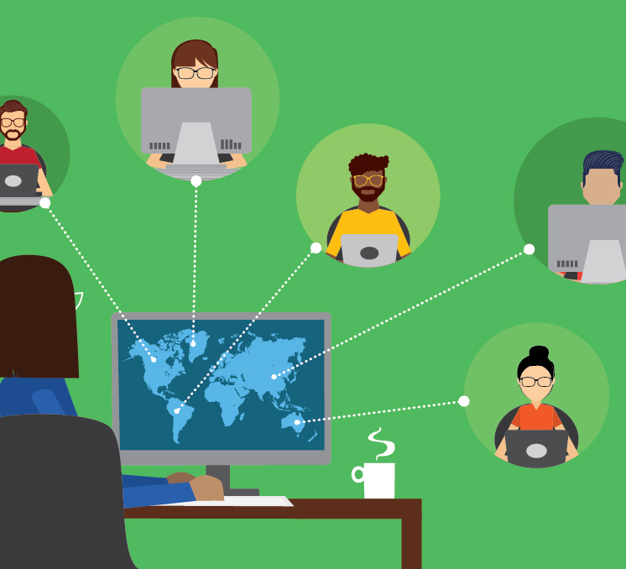
Questions Please
Submit questions by selecting the
Q&A window, typing your message, and hitting send.

Slide 34

Stay strong! We can help…
Join our next free webinar… May 12, 1:00-2:00pm EST, The Peculiar Mathematics of Real Influence, the next in our series on BEING INDISPENSABLE
Have me customize any webinar for your organization
Check out our on-line video training at RainmakerLearning.com
Pre-order my new book, The Art of Being Indispensable at Work (Harvard Business Review Press, July 2020)
Contact us at brucet@rainmakerthinking.com

